Slide 1
Introduction to Statistical Methods
ISM Team

Slide 2
Session 2
(8th & 9th August 2026)
Axioms of Probability, Probability basics, Mutually exclusive and Independent events

Slide 3
Module 1: (Basic Probability & Statistics)
Module 1: (Basic Probability & Statistics)
Contact Session | List of Topic Title | Reference
CS - 2 | Axioms of Probability, Mutually exclusive and independent events, Problem solving to understand basic probability concepts | T1 & T2

Slide 4
Agenda
Experiments, assignment of probabilities
Events and their probability
Some basic relationships of probability
Basic problem solving.

Slide 5
Introduction to Probability

Slide 6
Random Experiment
Flip a coin. Did it land with heads or tails facing up?
Walk to a bus stop. How long do you wait for the arrival of a bus?
Give a lecture. How many students are listening?
Transmit one of a collection of waveforms over a channel. What waveform arrives at the receiver?
Transmit one of a collection of waveforms over a channel. Which waveform does the receiver identify as the transmitted waveform?

Slide 7
Random Experiment
The term "random experiment" is used to describe any action whose outcome is not known in advance.
Examples:
Counting how many times a certain word or a combination of words appears in the text of the “King Lear” or in a text of Confucius.
Pulling a card from the deck.
Monitor three consecutive phone calls going through a telephone switching office. Classify each one as a voice call (v) if someone is speaking, or a data call (d) if the call is carrying a modem or fax signal.

Slide 8
Sample Space
The sample space of a random experiment is a set S that includes all possible outcomes of the experiment.
Example:
If the experiment is to throw a die and record the outcome, then, sample space is S = { 1,2,3,4,5,6}
Manufacture an integrated circuit and test it to determine whether it meets quality objectives. The possible outcomes are “accepted” (a) and “rejected” (r). The sample space is S ={a,r}.

Slide 9
Event
An event is a subset of the sample space of a random experiment.
An event is a set of outcomes of the experiment. This includes the null (empty) set of outcomes and the set of all outcomes.
Each time the experiment is run, a given event A either occurs, if the outcome of the experiment is an element of A, or does not occur, if the outcome of the experiment is not an element of A.

Slide 10

Complement of an Event
The complement of event A is defined to be the event consisting of all sample points that are not in A.
The complement of A is denoted by A^{c}.
The Venn diagram below illustrates the concept of a complement.

Slide 11

Union of Two Events
The union of events A and B is the event containing all sample points that are in A or B or both.
The union is denoted by A U B
The union of A and B is illustrated below.

Slide 12

Intersection of Two Events
The intersection of events A and B is the set of all sample points that are in both A and B.
The intersection of A and B is the area of overlap in the illustration below.

Slide 13

Mutually Exclusive Events
Two events are said to be mutually exclusive if the events have no sample points in common. That is, two events are mutually exclusive if, when one event occurs, the other cannot occur.

Slide 14

Definition of Probability
Classical approach:

Slide 15
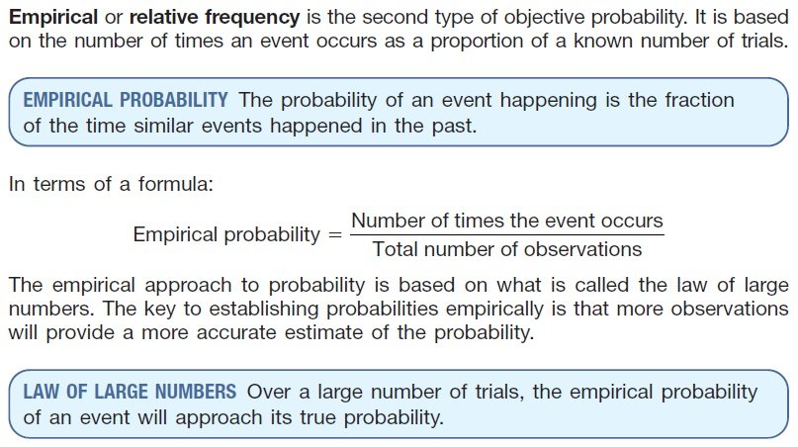

Empirical approach

Slide 16
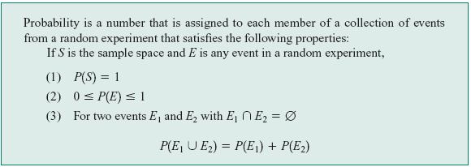
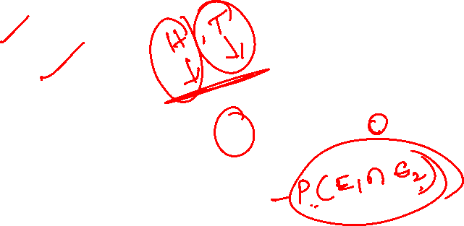
Axiomatic approach
Definition :

Slide 17

Probability as a Numerical Measure of the Likelihood of Occurrence
Increasing Likelihood of Occurrence
0
.5
1
Probability:
The occurrence of the event is
just as likely as it is unlikely.

Slide 18
The Addition Rule
The probability that event A or B will occur is given by
P (A U B) = P (A) + P (B) – P (A ∩ B ).
If events A and B are mutually exclusive, then the rule can be simplified to
P (A U B) = P (A) + P (B).

Slide 19
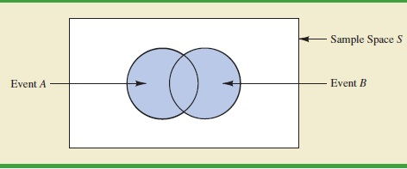

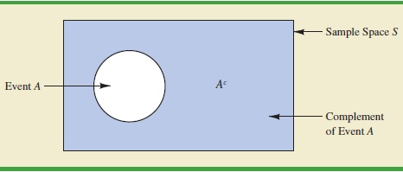

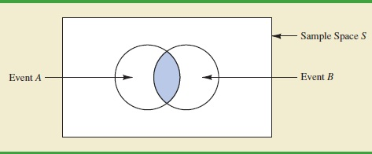
Probability and Venn Diagram

Slide 20
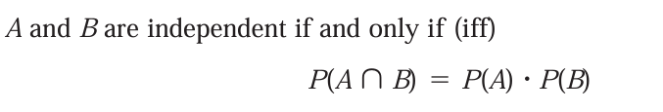
Independent & Dependent
Events are either
  Independent (the occurrence of one event has no effect on the probability of occurrence of the other) or
  Dependent (the occurrence of one event gives information about the occurrence of the other)

Slide 21
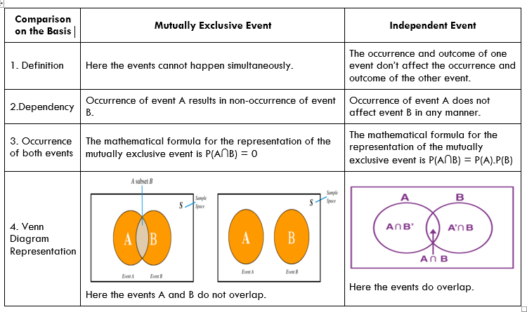
Comparison between Mutually Exclusive events and Independent Events

Slide 22
Example 1
An experiment has the four possible mutually exclusive outcomes A, B, C, D. Check whether the following assignments of probability are permissible:
P(A)= 0.38, P(B) = 0.16, P(C) =0.11, P(D) = 0.35 Permissible
P(A)= 0.31, P(B) = 0.27, P(C) =0.28, P(D) = 0.16 NOT
P(A)= 0.32, P(B) = 0.27, P(C) = -0.06, P(D) = 0.47 NOT
P(A)= 1/2, P(B) = 1/4, P(C) = 1/8, P(D) = 1/16 NOT
P(A)= 5/8, P(B) = 1/6, P(C) = 1/3, P(D) = 2/9 NOT

Slide 23
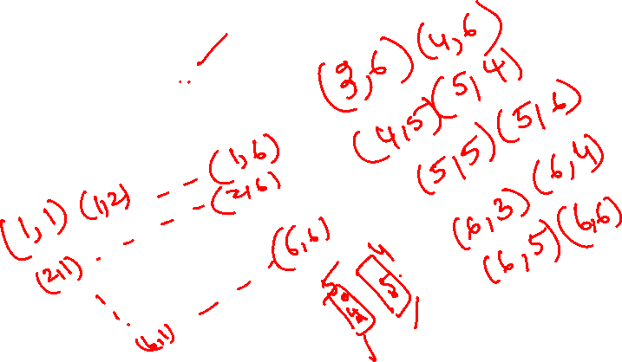
Example 2
If two dice are thrown , what is the probability that the sum is
Greater than 8
Less than 6
Neither 7 nor 11

Slide 24
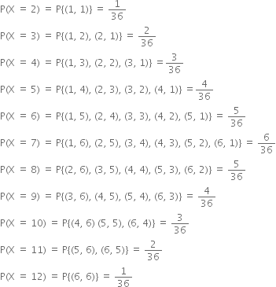
Solution
Probability of outcome, when a pair of die is thrown:

Slide 25

































Continued..
If two dice are thrown , what is the probability that the sum is
Greater than 8
b)Less than 6:

Slide 26

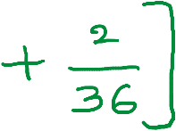















Continued
c) Neither 7 nor 11

Slide 27
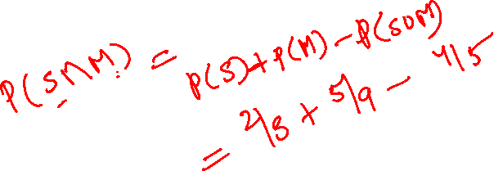
Example 3
The probability that a student passes in statistics examination is 2/3 and the probability that he /she will not pass in mathematics examination is 5/9. The probability that he/she will pass in at least one of the examination is 4/5. Find the probability that he /she will pass in both the examinations

Slide 28
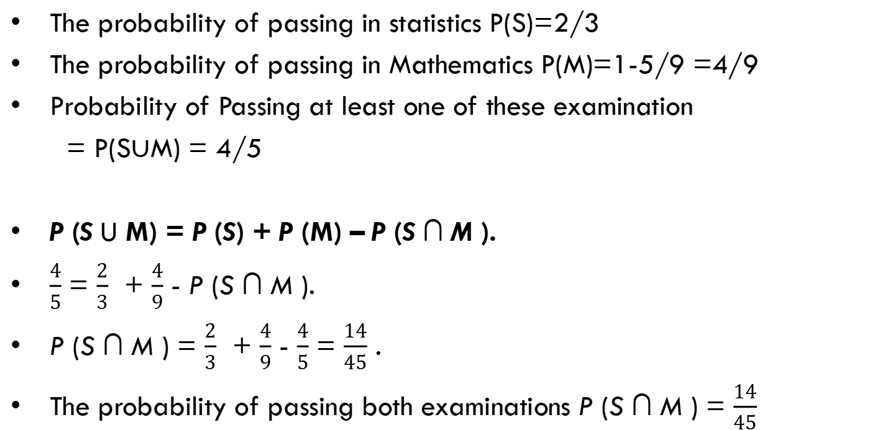
Solution
The probability of passing in statistics P(S)=2/3
The probability of passing in Mathematics P(M)=1-5/9 =4/9
Probability of Passing at least one of these examination
= P(S$∪$M) = 4/5
P (S U M) = P (S) + P (M) – P (S ∩ M ).
$\frac{4}{5}$ = $\frac{2}{3}$ + $\frac{4}{9}$ - P (S ∩ M ).
P (S ∩ M ) = $\frac{2}{3}$ + $\frac{4}{9}$ - $\frac{4}{5}$ = $\frac{14}{45}$ .
The probability of passing both examinations P (S ∩ M ) = $\frac{14}{45}$

Slide 29

Example 4
Suppose that 75% of all investors invest in traditional annuities and 45% of ALL investors invest in the stock market. If 85% invest in the stock market and/or traditional annuities, what percentage invest in both?

Slide 30
Solution
Let A be the event that a randomly selected investor invests in traditional annuities.
Let B be the event that he or she invests in the stock market.
Then P (A) = 0.75, P (B) = 0.45, and P (A ∪ B) = 0.85
Since,
P (A ∩ B) = P (A) + P (B) − P (A ∪ B)
= 0.75 + 0.45 − 0.85
= 0.35.

Slide 31
Example 5
Suppose the manufacturer’s specifications for the length of a certain type of computer cable are 2000 ± 10 millimeters. In this industry, it is known that small cable is just as likely to be defective (not meeting specifications) as large cable. That is, the probability of randomly producing a cable with length exceeding 2010 millimeters is equal to the probability of producing a cable with length smaller than 1990 millimeters. The probability that the production procedure meets specifications is known to be 0.99.
What is the probability that a cable selected randomly is too large?
(b) What is the probability that a randomly selected cable is larger than 1990 millimeters?

Slide 32
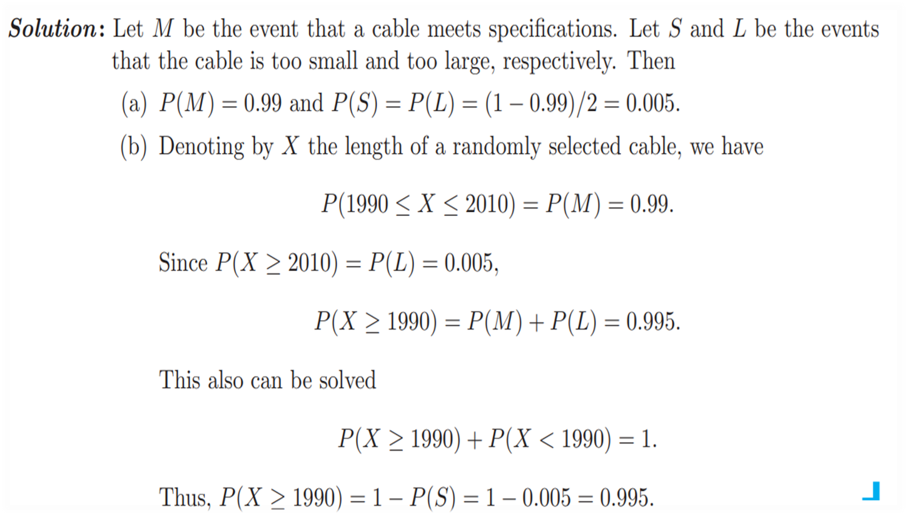
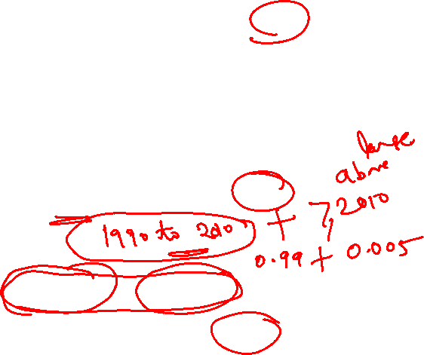
Solution

Slide 33

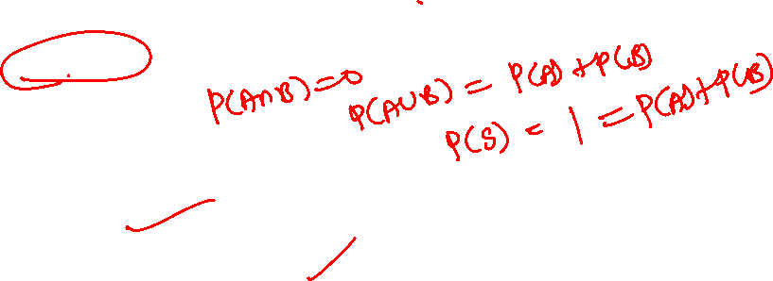
Example 6
Let S be a sample space and A and B are two mutually exclusive events such that AUB = S. If P(.) denotes the probability of the event, then what is the maximum value of P(A).P(B)?
Solution:
So, P(A) = P(B) = ½
Hence P(A).P(B) = 1/4

Slide 34
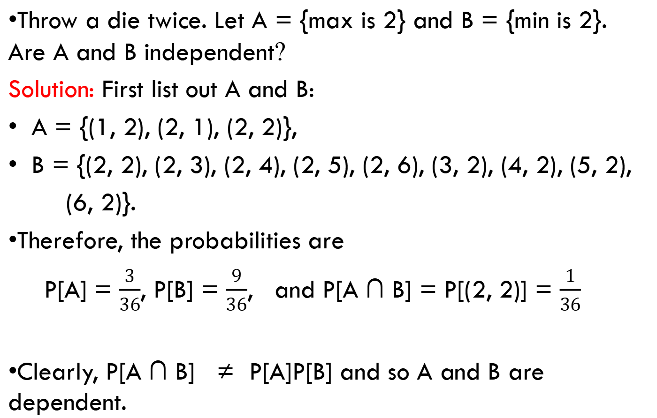
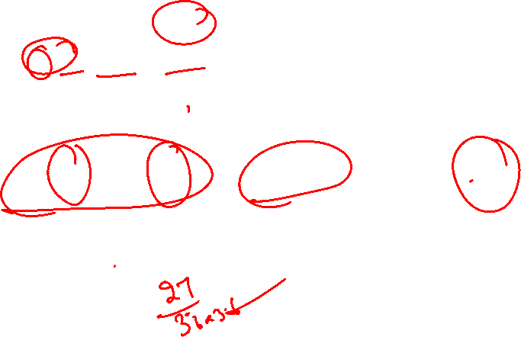
Example 7
Throw a die twice. Let A = {max is 2} and B = {min is 2}. Are A and B independent?
Solution: First list out A and B:
A = {(1, 2), (2, 1), (2, 2)},
B = {(2, 2), (2, 3), (2, 4), (2, 5), (2, 6), (3, 2), (4, 2), (5, 2),
(6, 2)}.
Therefore, the probabilities are
P[A] = $\frac{3}{36}$, P[B] = $\frac{9}{36}$, and P[A ∩ B] = P[(2, 2)] = $\frac{1}{36}$
Clearly, P[A ∩ B] ≠ P[A]P[B] and so A and B are dependent.

Slide 35

Example 8
The computers of six faculty members in a certain department are to be replaced. Two of the faculty members have selected laptop machines and the other four have chosen desktop machines. Suppose that only two of the setups can be done on a particular day, and the two computers to be set up are randomly selected from the six (implying 15 equally likely outcomes; if the computers are numbered 1, 2, . . . , 6, then one outcome consists of computers 1 and 2, another consists of computers 1 and 3, and so on).
(implying 15 equally likely outcomes; if the computers are numbered 1, 2, . . . , 6, then one outcome consists of computers 1 and 2, another consists of computers 1 and 3, and so on).
[(1,2),(1,3), (1,4), (1,5), (1,6),(2,3), (2,4), (2,5), (2,6),(3,4), (3,5), (3,6), (4,5), (4,6), (5,6)]

Slide 36
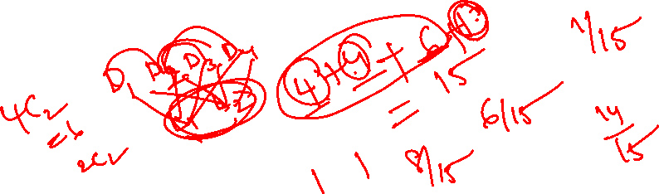
Example 8
[(1,2),(1,3), (1,4), (1,5), (1,6),(2,3), (2,4), (2,5), (2,6),(3,4), (3,5), (3,6), (4,5), (4,6), (5,6)]
What is the probability that both selected setups are for laptop computers?
What is the probability that both selected setups are desktop machines?
What is the probability that at least one selected setup is for a desktop computer?
What is the probability that at least one computer of each type is chosen for setup?

Slide 37
Solution
[(1,2),(1,3), (1,4), (1,5), (1,6),(2,3), (2,4), (2,5), (2,6),(3,4), (3,5), (3,6), (4,5), (4,6), (5,6)]
In the exercise, it is described that the computers are numbered from one to six, and that the first two (computer 1 and computer 2) are the laptops. All possible outcomes are
{1,2},{1,3},{1,4},{1,5},{1,6},{2,3},{2,4},{2,5},{2,6},{3,4},{3,5},
{3,6},{4,5},{4,6},{5,6}​​
because we select only two computers out of six, randomly.
All the outcomes have the same probability which is 1/15.
And we have 15 outcomes

Slide 38
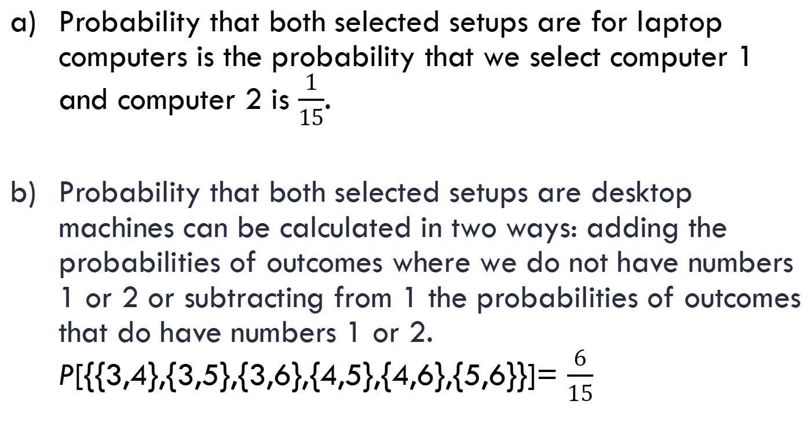
Contd..
[(1,2),(1,3), (1,4), (1,5), (1,6),(2,3), (2,4), (2,5), (2,6),(3,4), (3,5), (3,6), (4,5), (4,6), (5,6)]
Probability that both selected setups are for laptop computers is the probability that we select computer 1 and computer 2 is $\frac{1}{15}$.
Probability that both selected setups are desktop machines can be calculated in two ways: adding the probabilities of outcomes where we do not have numbers 1 or 2 or subtracting from 1 the probabilities of outcomes that do have numbers 1 or 2. P[{{3,4},{3,5},{3,6},{4,5},{4,6},{5,6}}]= $\frac{6}{15}$

Slide 39
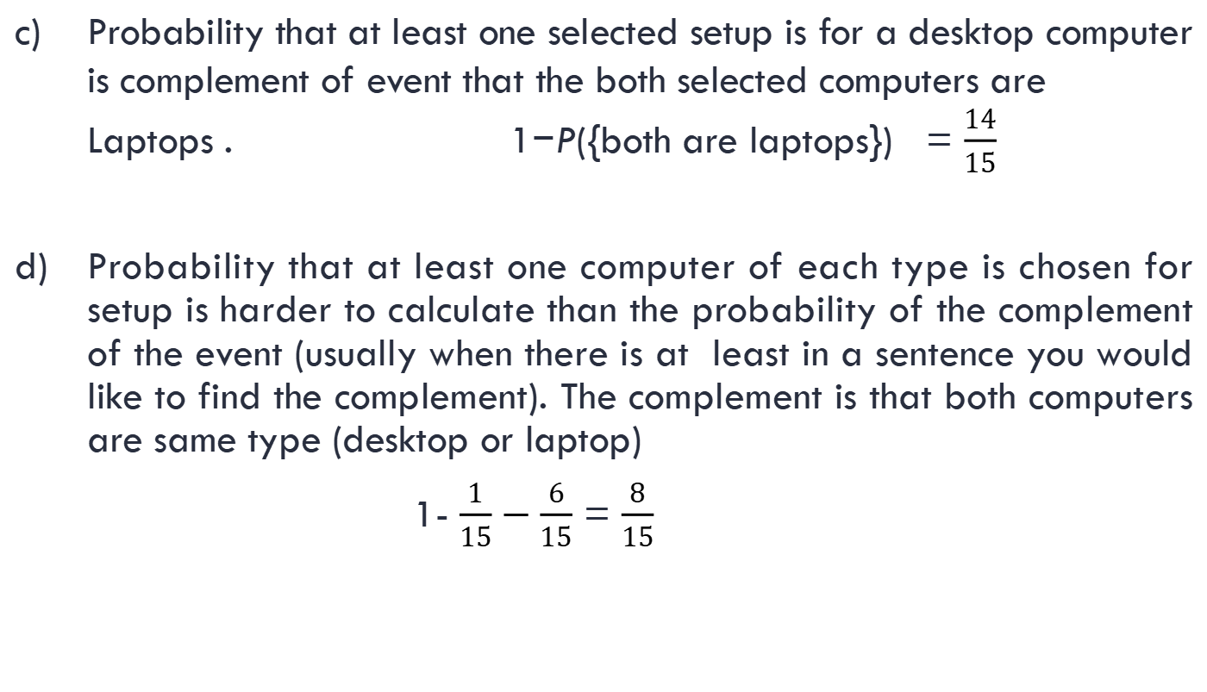
Contd..
[(1,2),(1,3), (1,4), (1,5), (1,6),(2,3), (2,4), (2,5), (2,6),(3,4), (3,5), (3,6), (4,5), (4,6), (5,6)]
Probability that at least one selected setup is for a desktop computer is complement of event that the both selected computers are Laptops . 1−P({both are laptops}) = $\frac{14}{15}$
Probability that at least one computer of each type is chosen for setup is harder to calculate than the probability of the complement of the event (usually when there is at least in a sentence you would like to find the complement). The complement is that both computers are same type (desktop or laptop)
1- $\frac{1}{15}−\frac{6}{15}$ = $\frac{8}{15}$

Slide 40
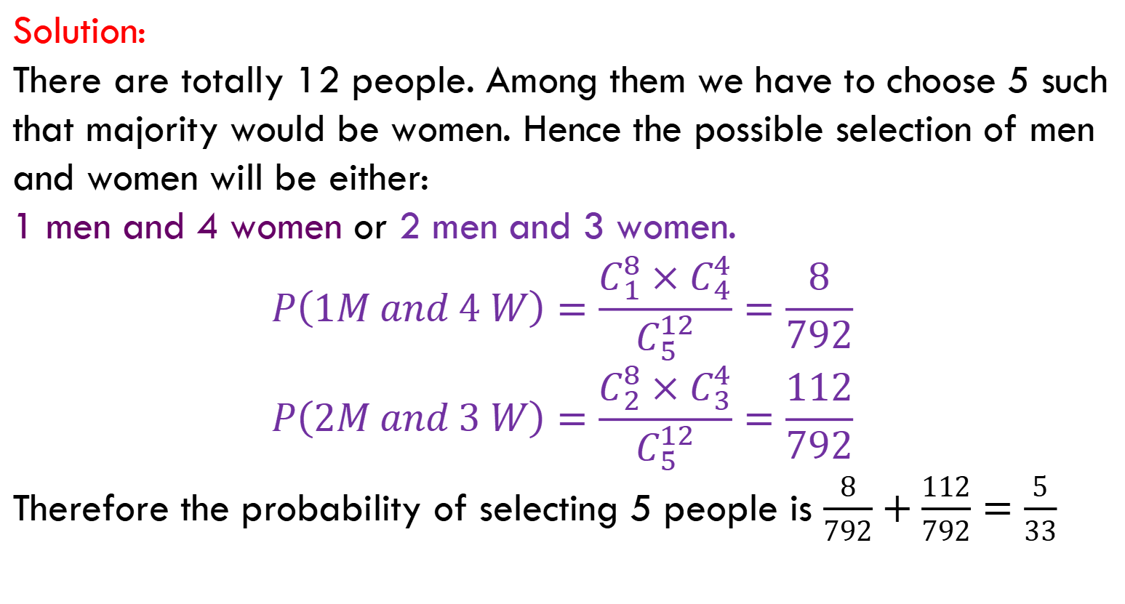
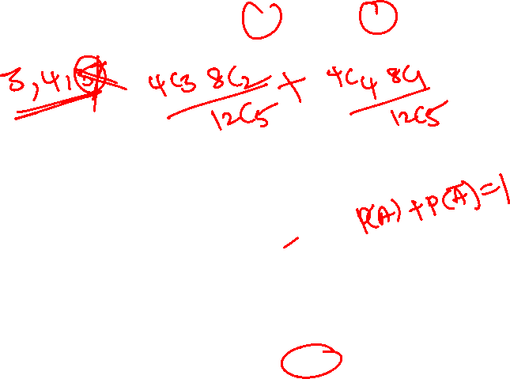
Example 9
A committee of 5 is chosen from a group of 8 men and 4 women. What is the probability that the group contains a majority of women?
Solution:
There are totally 12 people. Among them we have to choose 5 such that majority would be women. Hence the possible selection of men and women will be either:
1 men and 4 women or 2 men and 3 women.
$$P\left(1M and 4 W\right)=\frac{C_{1}^{8}×C_{4}^{4}}{C_{5}^{12}}=\frac{8}{792}$$
$$P\left(2M and 3 W\right)=\frac{C_{2}^{8}×C_{3}^{4}}{C_{5}^{12}}=\frac{112}{792}$$
Therefore the probability of selecting 5 people is $\frac{8}{792}+\frac{112}{792}=\frac{5}{33}$

Slide 41
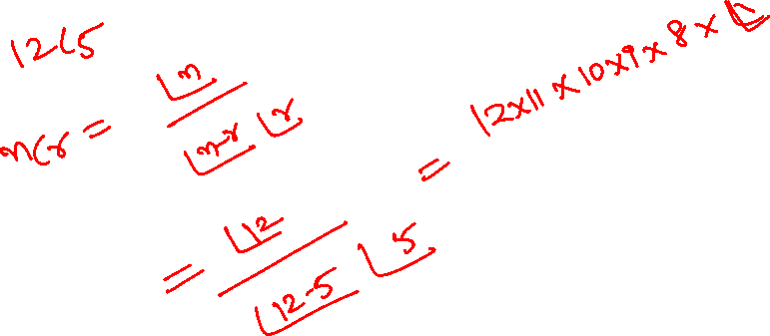

Slide 42
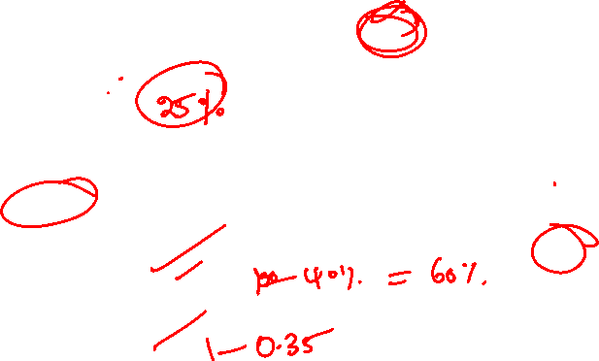
Practice problems
Q1: A Survey conducted by a bank revealed that 40% of the accounts are savings accounts and 35% of the accounts are current accounts and the balance are loan accounts.
What is the probability that an account taken at random is a loan account ? Ans: 0.25
What is the probability that an account taken at random is NOT savings account ? Ans: 0.60
What is the probability that an account taken at random is NOT a current account ? Ans: 0.65
What is the probability that an account taken at random is a current account or a loan account? Ans: 0.60

Slide 43
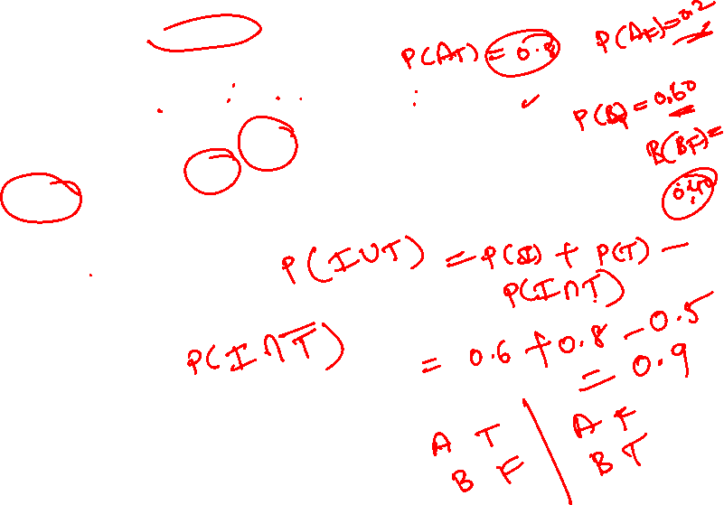
Practice Problems
Q2. A speaks truth in 80% cases and B speaks in 60% cases. What percentage of cases are they likely to contradict each other in stating the same fact.
Hint / Ans: P(Contradiction)=P(A truth and B false)+P(A false and B truth)=0.32+0.12=0.44
Q3. In a certain residential suburb, 60% of all households get Internet service from the local cable company, 80% get television service from that company, and 50% get both services from that company. If a household is randomly selected,
What is the probability that it gets at least one of these two services from the company?
Ans: P(Internet or Television)=0.90
What is the probability that it gets exactly one of these services from the company?
Ans: P(Exactly one service)=P(Internet but not Television)+P(Television but not Internet)=0.10+0.30=0.40

Slide 44
Practice problems
Q4: The next generation of miniaturised wireless capsules with active locomotion will require two miniature electric motors to manoeuvre each capsule. Suppose 10 motors have been fabricated but that, in spite of test performed on the individual motors 2 will not operate satisfactorily when placed into capsule, to fabricate a new capsule,2 motors will be randomly selected(that is, each pair of motors has the same chance of being selected ) find the probability that
Both motors will operate satisfactorily in the capsule.
One motor will operate satisfactorily and other will not.

Slide 45
Practice problems
Q5. Suppose that 55% of all adults regularly consume coffee, 45% regularly consume carbonated soda, and 70% regularly consume at least one of these two products.
i) What is the probability that a randomly selected adult regularly consumes both coffee and soda?
ii) What is the probability that a randomly selected adult doesn’t regularly consume at least one of these two products?

Slide 46
Practice problems
Q6. Suppose a student is selected at random from 80 students where 30 are taking mathematics, 20 are taking chemistry and 10 are taking both. Find the probability ‘p’ that the student is taking Mathematics or chemistry?.
Q7. If A and B are events with P(A U B) = 7/8,
P(A ∩ B) = ¼ and P(A') = 5/8, find P(A), P(B) and P(A ∩ B').

Slide 47
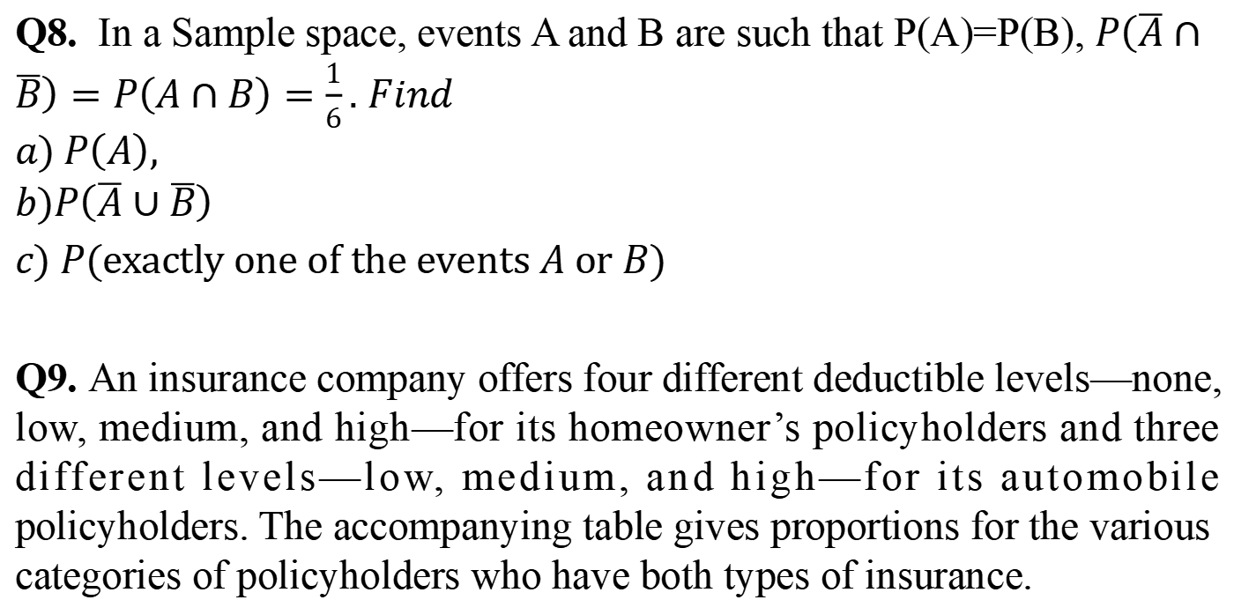
Practice problems
Q8. In a Sample space, events A and B are such that P(A)=P(B), $P\left(\overline{A}∩\overline{B}\right)=P\left(A∩B\right)=\frac{1}{6}.$ $Find$
$$a) P\left(A\right),$$
$$b)P\left(\overline{A}∪\overline{B}\right)$$
$c) P(exactly one of the events A or B)$
Q9. An insurance company offers four different deductible levels—none, low, medium, and high—for its homeowner’s policyholders and three different levels—low, medium, and high—for its automobile policyholders. The accompanying table gives proportions for the various categories of policyholders who have both types of insurance.

Slide 48
Practice problems
For example, the proportion of individuals with both low homeowner’s deductible and low auto deductible is .06 (6% of all such individuals.
Homeowner’s
Auto | N | L | M | H
L | 0.04 | 0.06 | 0.05 | 0.03
M | 0.07 | 0.10 | 0.20 | 0.10
H | 0.02 | 0.03 | 0.15 | 0.1

Slide 49
Suppose an individual having both types of policies is randomly selected.
a. What is the probability that the individual has a medium auto deductible and a high homeowner’s deductible?
b. What is the probability that the individual has a low auto deductible? A low homeowner’s deductible?
c. What is the probability that the individual is in the same category for both auto and homeowner’s deductibles?
d. Based on your answer in part (c), what is the probability that the two categories are different?
e. What is the probability that the individual has at least one low-deductible level ?
f. Using the answer in part (e), what is the probability that neither deductible level is low ?

Slide 50
Glossary
Random experiment- an experiment whose outcome is uncertain before performing it.
Sample space-set of all possible outcomes of an experiment.
Event- outcome of an experiment.
Equally Likely Outcomes – Outcomes which are having same probability
Mutually exclusive events-events that do not occur at the same time.
Independent events- the events which occur freely of each other.
Operations on events
  Union of events and its probability
  Intersection of events and its probability
  Complement of an event and its probability

Slide 51
Thank You!

